Slide 1
UC ONLINE LIB
Villete, Richard D.

Slide 2
UC LIBRARY
UC Library is an application that can help you access the University’s library and borrowing books just got easier with just a touch of a finger.

Slide 3
FEATURES
Search Button
List of Books
Digital Borrower’s Card

Slide 4

LAYOUT- splash screen
Content: Set to 4000 millis = 4sec image view text view

Slide 5
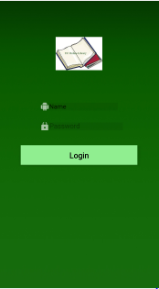
LAYOUT - login preview
Content: Image view Edit Text (2) Button

Slide 6
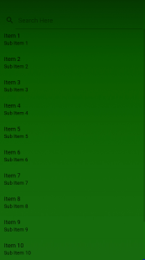
LAYOUT – search preview
Content: search view list view

Slide 7
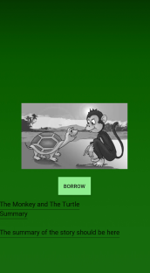
Borrowing

